Slide 1
Volunteer Management System
Presented by Dio Phung

Slide 2
Content
Introduction
Overview of Requirements
Project Plan
Progress
Challenges Encountered
High Level Architecture
Project Risks
Transition to Next Stage
Q & A

Slide 3

Introduction
Volunteer Management System

Slide 4
Introduction – Organisation Background
Objective of Non-profitable Organisation (NGO) – Eliminate poverty
Has grown tremendous over the years which attracts more volunteers.
A need to coordinate and manage the volunteers.
Manual handling of paperwork and volunteers requires lots of work and limits the efficiency of the organisation.

Slide 5
Introduction – System Objective
To provide an integrated system with the aim of addressing the problems of volunteer communication, documentation, recruitment and retention.

Slide 6
Overview Of Requirements
Volunteer Management System

Slide 7
Overview of Requirements
Volunteer Management
Staff Management
Project Management
Itinerary Management
Administration

Slide 8
Project Plan
Volunteer Management System

Slide 9
Project Plan – Team structure
No | Name | Role
1. | Phung Kim Cuong, Dio | Project Manager
2. | Zaw Htet | Technical Lead
3. | Thida Khin Myo Thaung | Business Analyst
4. | Hnin Nu Aye | Business Analyst
5. | Feng Yan | Development Lead
6. | Jiang Jifa | Test Lead
7. | Liu Peishan | Quality Manager
Note: All team members will be programmer as well.

Slide 10
Project Plan – Gantt Chart
Pending to insert Gantt chart.

Slide 11
Project Plan – Milestones
Pending to insert milestones.

Slide 12
Project Plan – Estimates Comparison
Pending to insert COCOMO

Slide 13
Progress
Volunteer Management System

Slide 14
Progress
Pending to insert a table on the progress so far.

Slide 15
Challenges Encountered
Volunteer Management System

Slide 16
Challenges Encountered
No | Challenge | Description | Solution
1. | Communications | Difficulty to gather all members for discussions. | Online meeting via Skype To fix a weekly meeting time
2. | Requirements Gathering | Client only wants a small set of requirements. | Seek lecturers advice Proposed merging of requirements
3. | Task Control | Not able to meet deadline on time. | To log time log To hold meetings to track status
4. | Low Quality of Work | Deliverables not up to standard. | Perform reviews Conduct briefing and demo on required items

Slide 17
High Level Architecture
Volunteer Management System

Slide 18
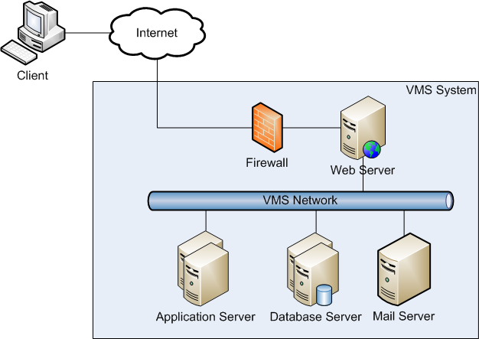
High Level Architecture –Architecture Overview

Slide 19
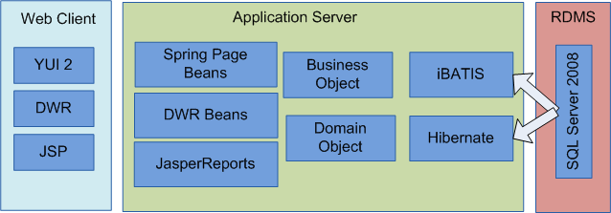
High Level Architecture – Overview of Components

Slide 20
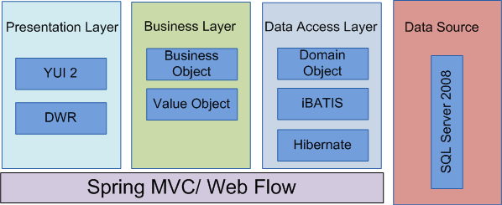
High Level Architecture – Framework Overview

Slide 21
Project Risks
Volunteer Management System

Slide 22
Project Risks
Pending for Project Risks.

Slide 23
Transition to Next Stage
Volunteer Management System

Slide 24
Transition to Next Stage – Where are we now?
Project Planning
Analysis and Design
Prototyping
Use Case Modeling
Use Case Realisation Report
High-level System Design
Software Architecture
Transition Strategy from Analysis to Design
Project Management

Slide 25
Transition to Next Stage – What do we plan to do?
No | Task | Description | In-Charge
1. | Prototyping | User interface prototyping Technical prototyping | Feng Yan, Jifa Zaw
2. | Use Case Modeling | Use case model survey | Thida, Hazel
3. | Use case realisation report | Use case realisation report | Thida, Hazel
4. | Software Design | High level software architecture design document | Zaw
5. | Transition Strategy from Analysis to Design | Transition Strategy from Analysis to Design | Zaw
6. | Project Management | Transition Strategy from Analysis to Design | Dio

Slide 26
Question & Answer

